Slide 1
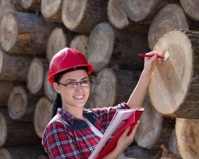
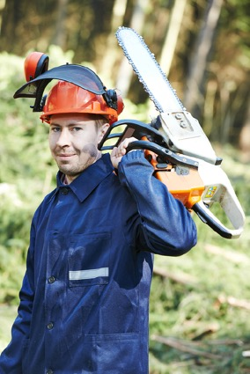
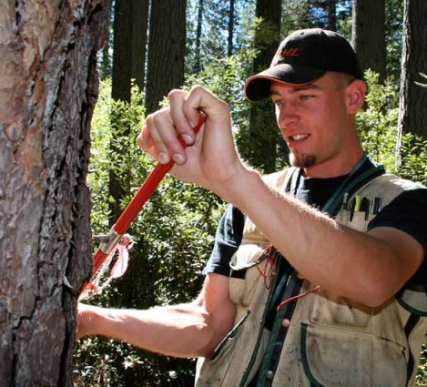

Slide 2
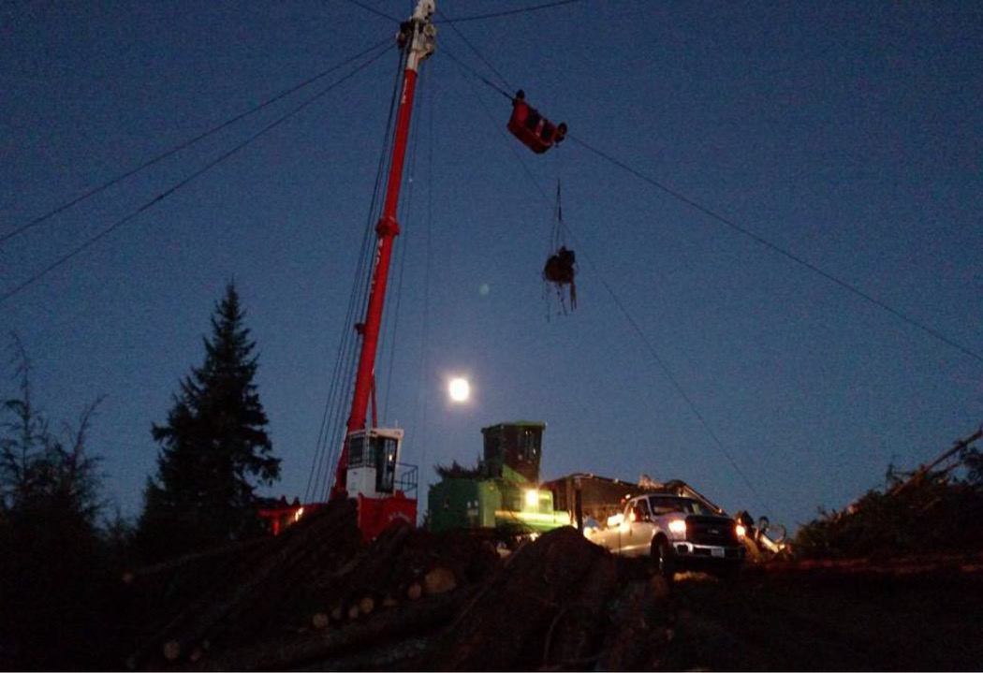

Slide 3
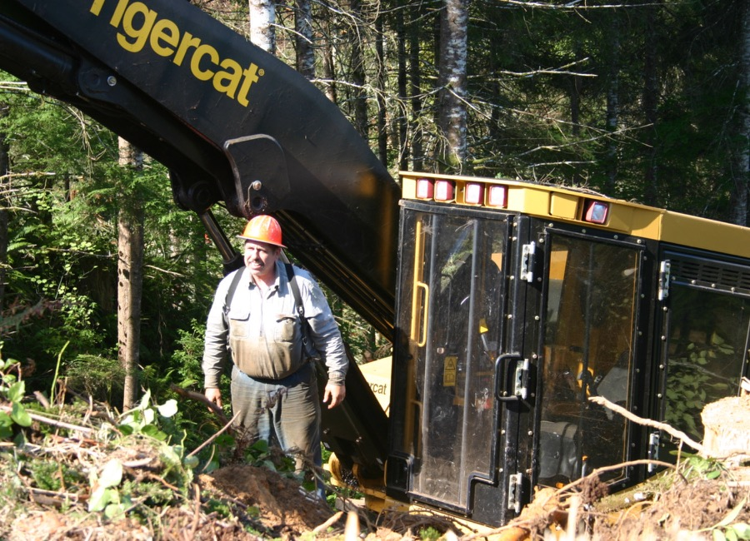
CAREER LOGGERS
42 years

Slide 4
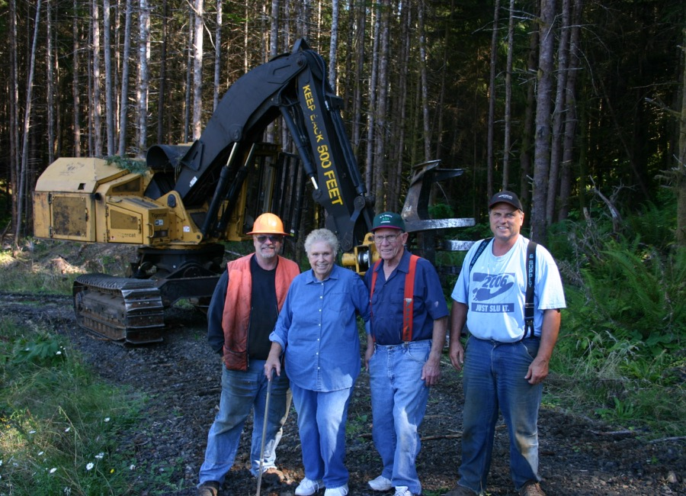
CAREER LOGGERS
39 years

Slide 5
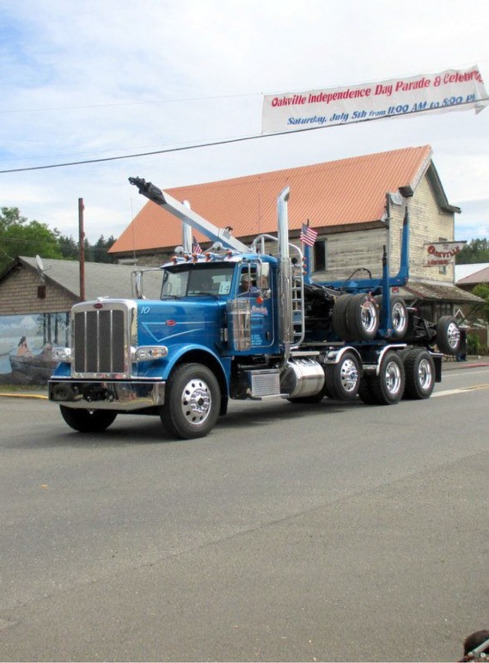
PRIDE IN THE INDUSTRY
Feeling of Accomplishment when finishing a job.
Seeing a job that was logged come back to life.
Something you are involved in benefits so many.
3rd crop rotation.
Sustainable forestry.
No one cares about the environment as much as loggers do because if we can’t grow trees, we don’t have a job.

Slide 6
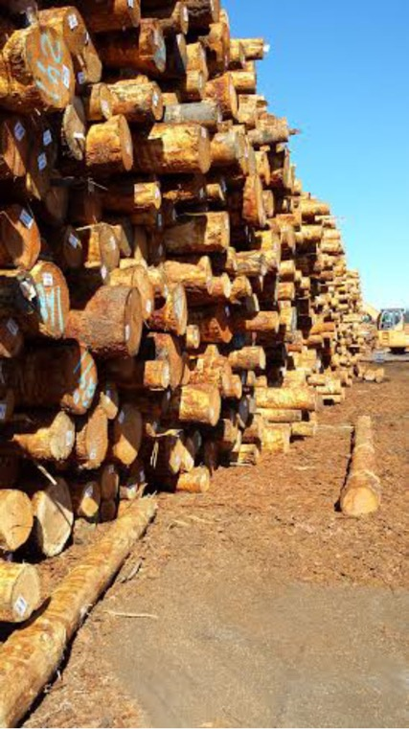
HOW MUCH WOOD??
Every person uses 4 pounds per day.
Renewable resource unlike steel and concrete.
Only energy needed is the free non polluting sun.
Removes carbon dioxide from the air.
Carbon dioxide becomes part of the wood and helps prevent global warming.

Slide 7
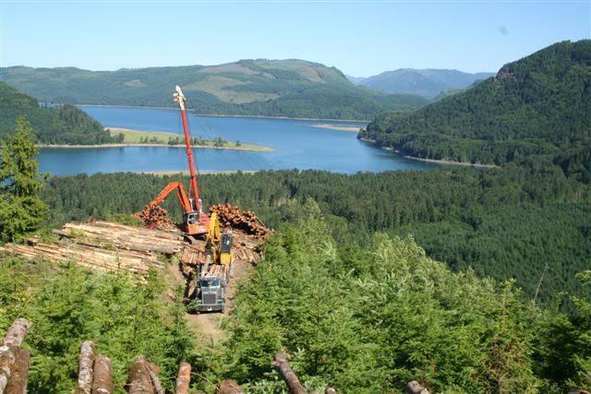
MY STORY…
How I got started
Opportunities to start a Business
Speedbumps and Milestones

Slide 8
HELPFUL HIGH SCHOOL CLASSES
Geometry
English and Debate
Math
Problem Solving and Teamwork

Slide 9
WHAT DOES IT TAKE?
Drug Free
Reliable
Physically Demanding
Responsible
Driver’s License

Slide 10
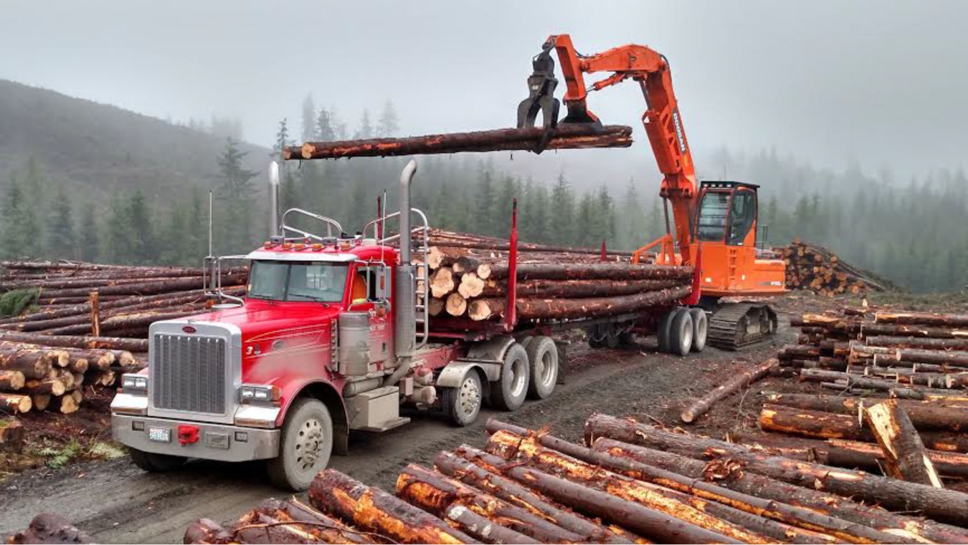
CAREER PATH

Slide 11
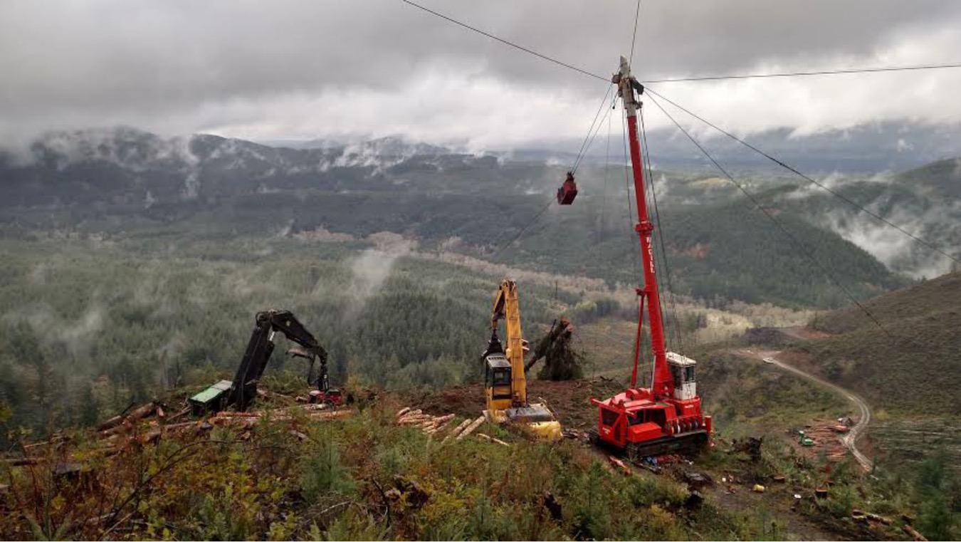
TEAMWORK,
COMMUNICATION, AND SAFETY

Slide 12
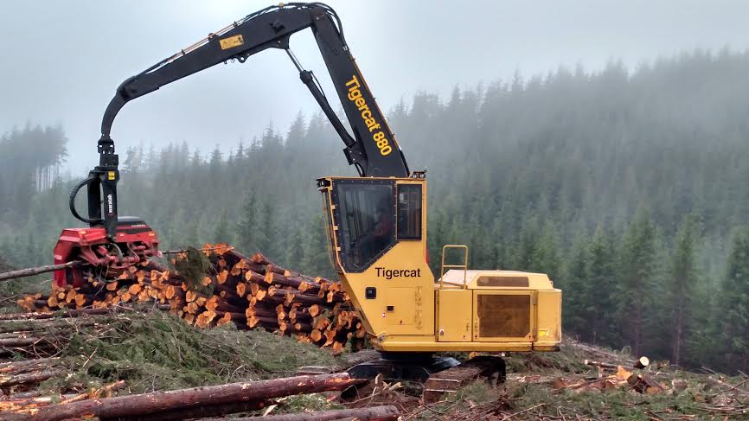
OPPORTUNITIES

Slide 13
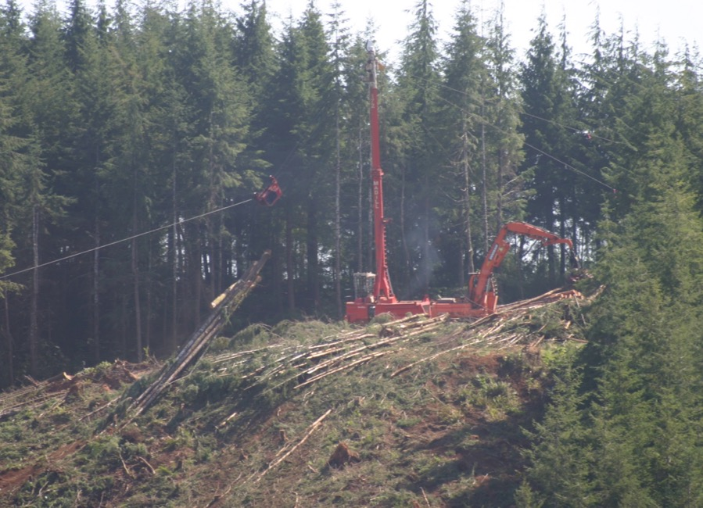
TOWER SIDE
Succession Planning

Slide 14
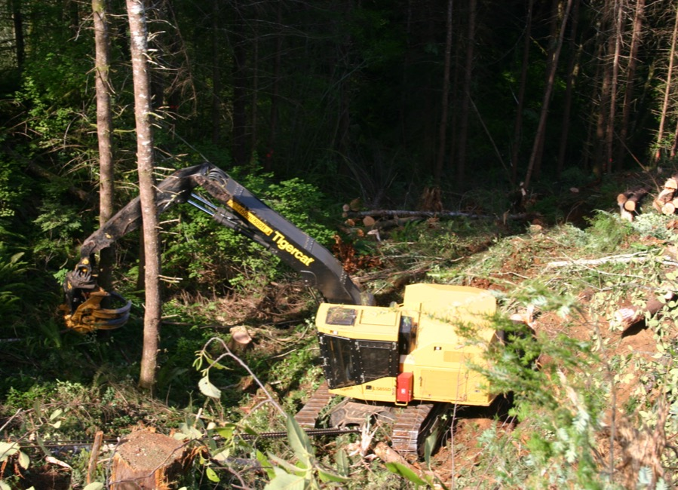
New Technology-TIGERCAT 855D

Slide 15
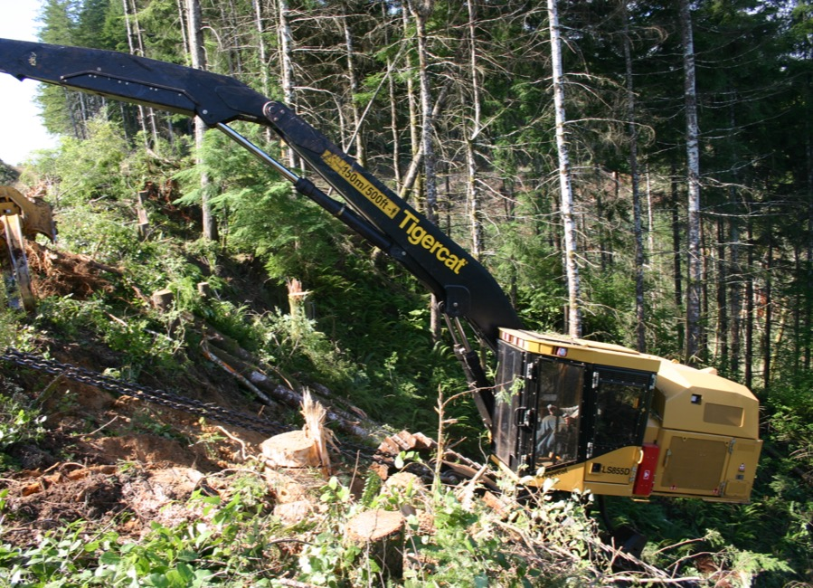
New Technology-WINCH ASSIST
Coming up the hill

Slide 16
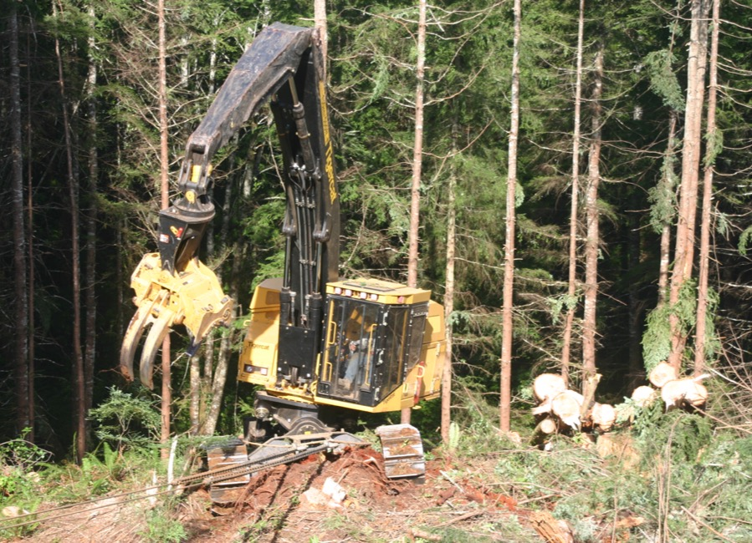
New Technology-TIGERCAT 855D
Making way up the hill

Slide 17
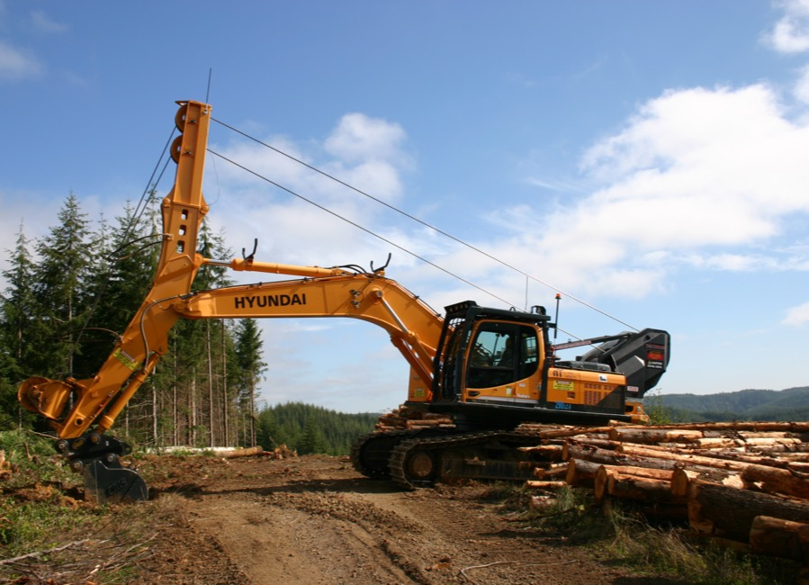
New Technology-EMS
Winch Assist

Slide 18
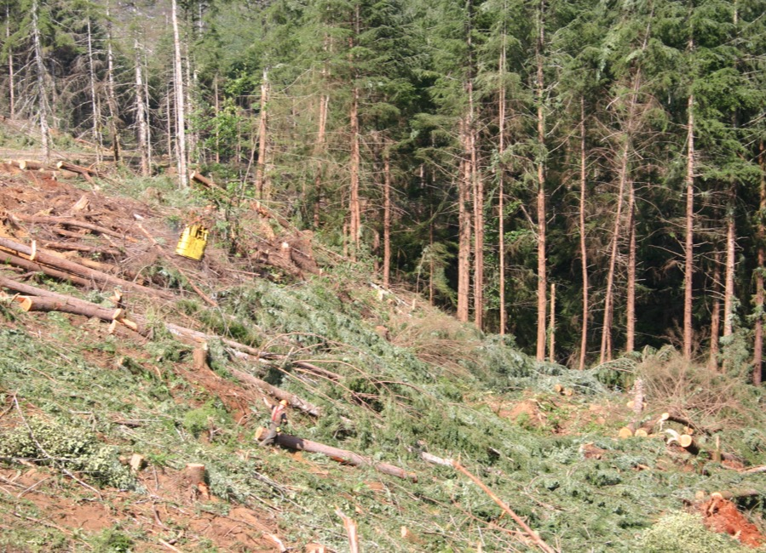
GROUND CREW
Yoder Side

Slide 19
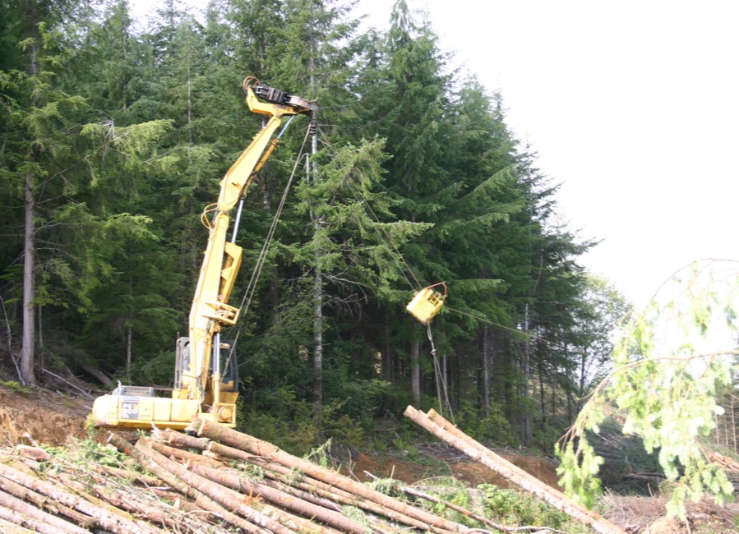
300-7 KOMATSU W/YODER
Bringing in a turn

Slide 20
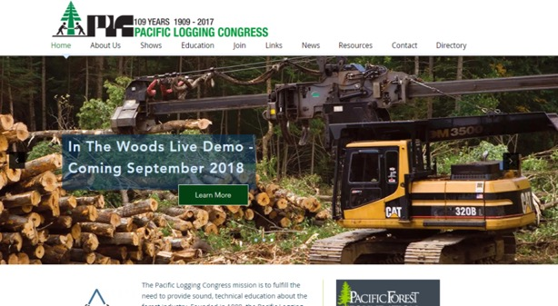
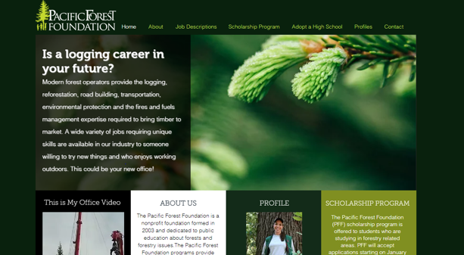
www.pacificloggingcongress.org www.pacificforestfoundation.org http://data.workingforests.org
VIDEOS
It Takes and Tree This is My Office websites have videos, job descriptions and job opportunities
WEBSITES

